Slide 1
Deep Learning Section -3
Done by, Sahana Lakshmipathy,
Naresh M, (Dune Dev Squad)

Slide 2
Objectives
Automated Heading, Summary, and Tag Generation using LED Model for content summarization.
To develop a system capable of generating concise headings, summaries, and tags from long paragraphs using a pre trained transformer-based LED model.
This system is aimed at improving content organization and SEO by automatically extracting relevant information from textual data.

Slide 3
Methodology
Data Preprocessing:
Input paragraphs are tokenized using a transformer tokenizer.
Text sequences are padded and truncated to ensure consistency in model input.
Model Architecture:
Pretrained LED (Longformer Encoder-Decoder) model is fine-tuned to generate headings, summaries, and tags.
Steps:
Tokenization: Converts text to numerical tokens using the LED tokenizer.
Heading Generation: Uses the model to generate a heading for the paragraph.
Summary Generation: Produces a summary of the paragraph using beam search for better quality.
Tag Extraction: Extracts key themes or tags from the paragraph based on important keywords.

Slide 4
Tech Stack
Python
Hugging Face Transformers Library (LED Model, LED Tokenizer)
PyTorch
CUDA

Slide 5
Load Model and Tokenizer:
Load the pretrained LED model and its tokenizer from hugging face using python.
Generate Heading:
Use the model to generate concise headings.
Generate Tags:
Extract key tags based on predefined keywords or NLP techniques.
Step 1
Step 2
Step 3
Step 4
Step 5
Input Tokenization:
Tokenize paragraphs and create attention masks.
Generate Summary:
Produce summaries using the model with beam search to optimize quality.

Slide 6
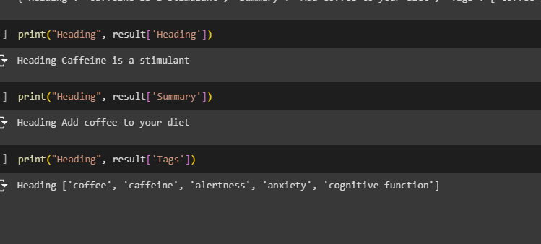
Project Output

